Slide 1
Bupa and MMB
Together, let’s lead the way for health and wellbeing.
Bupa. Better for business
Notes:
Speaker Notes:
Objective:
Welcome clients and/or intermediaries
Key points:
When creating your slide deck, consider the following points:
If the client/intermediary has provided a brief, ensure you answer all of their questions through your slide deck
If you’re hosting the meeting, consider the audience and topic and ensure the relevant Bupa people are attending the meeting
Brief the presenting team accordingly e.g. relationship history, high claims, attendees etc
Consider topics and assign roles to presenting team
Rehearse with team to ensure consistent story and aligned messaging
Considerations:
Client name can be added

Slide 2
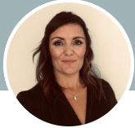
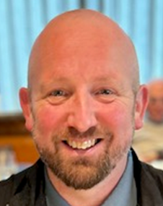
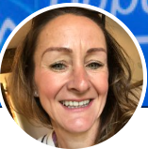
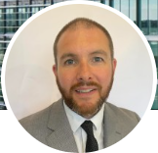
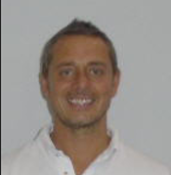
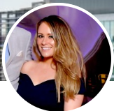
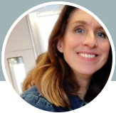
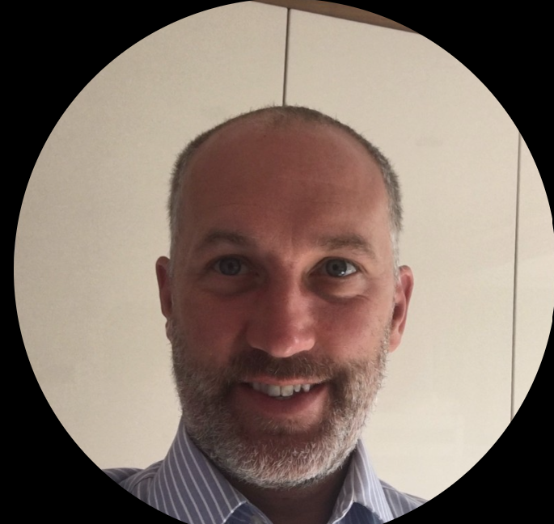
Meet the Bupa MMB Team
Kev Jepson
Sales Team Manager
kevin.jepson@bupa.com
07525 698 638
SME existing business
Kerry Walker
Head of Strategic Intermediary Partnerships
Kerry.walker@bupa.com
07709 482 312
Natasha Heasman
Commercial Manager
Natasha.heasman@bupa.com
07712 789 053
MMB Commercial
Robert Johnson
Business Development Manager
r.johnson@bupa.com
07801 888 369
MMB Commercial and Corporate
Ricky Cheetham
Corporate Consulting Leader
ricky.cheetham@bupa.com
07561 866 808
Corporate existing business
Amanda King-Smith
Business Development Manager
amanda.king-smith@bupa.com
07712 548 871
MMB Commercial
Jayne Rattray
Senior Business Development Manager
jayne.rattray@bupa.com
07736 892 038
Corporate new business 500+ reg’s
Tariq Ali
Corporate Consulting Leader
tariq.ali@bupa.com
07831 235 638
Corporate existing business
Brooke Malone
Business Development Manager
brooke.malone@bupa.com
07761 446 221
Corporate new business 50-500 reg’s
Danny Hodgson
Corporate Consulting Leader
daniel.hodgson@bupa.com
07712 789 500
Dental existing business
Shaun Renshaw
Sales Team Manager
shaun.renshaw@bupa.com
07751 733 085
SME New business

Slide 3
Intermediary Distribution
Rob Bain
Director of Distribution
Leo Dobson
Head of Sales – Specialist Products
Kerry Walker
Head of Intermediary Strategic Partnerships
Lorri-Ann Gilles
Head of Corporate Business Development
Brian Gilfillan
Head of Intermediary Sales (SME)
Jayne Rattray
Brooke Malone
Laura Boyle
1x Vacancy
Shaun Renshaw
Sales Team Manager
Natasha Heasman
Amanda King Smith
Robert Johnson
Benjamin Garrett
Samrah Raja Kiani
1x Vacancy

Slide 4
Corporate
Will Shaw
Director of Corporate
Nicole Sinclair
Head of Corporate (Insurance)
Sharon Ockleton
Head of Strategic Accounts and Health Trusts
Danny Hodgson
Corporate Consulting leader (Dental)
Ricky Cheetham
Corporate Consulting leader (Insurance)
Tariq Ali
Corporate Consulting leader (Trust)
Dannielle Zammit
Sarah Gardener
Samantha Jones
Bilal Siddiqui
1x vacancy
Mark Perrin
Fiona McWilliams
Robert Burrows
David Roberts
Zainab Malik
Emma Codd
Simon Prato-Scarlett
1x Vacancy
Johnathan Dooley
Stewart Maclean

Slide 5
Commercial
Emma Walkley
Director of SME
Machaela Roberts
Head of SME Retention
Bernie Robert
SME Retention Telesales Manager
Kevin Jepson
Sales Team Manager
Mark Hudson
Robyn Horsefield
Allyson Gould
Keiron Hatton
Harry Tomlinson
Alen Ekong
Paul Hutchinson
Jovan Parchment

Slide 6
Clinics
Nic Green
Commercial & Trading Director
Gary Williams
Head of SME & Consumer
Aisling Burgess
Head of Corporate Intermediary
Dan Johnson
Business Development Manager
Pam Walker
Sales Team manager
Emily Knowles
Business Development Manager
Andrew Redfern
Joanne Carney
Nicola Ward

Slide 7
Contact sheet
Contact | Job title | Email | Phone | notes
Intermediary Distribution
Kerry Walker | Head of Intermediary strategic partnerships | Kerry.walker@bupa.com | 07709 482 312
Natasha Heasman | Commercial manager | Natasha.heasman@bupa.com | 07712 789 053 | (SME)
Amanda King Smith | Business Development Manager | amanda.king-smith@bupa.com | 07712 548 871 | Supports commercial relationship
Robert Johnson | Business Development Manager | r.johnson@bupa.com | 07801 888 369 | Supports both commercial and corporate relationship
Corporate Existing Business including dental PPA
Ricky Cheetham | Consulting team leader | ricky.cheetham@bupa.com | 07561 866 808 | Insurance business
Tariq Ali | Consulting team leader | tariq.ali@bupa.com | 07831 235 638 | Health Trust business
Mark Perrin | Corporate Health Insurance consultant | mark.perrin@bupa.com | 07895 300 693 | Field presence
Stewart Maclean | Corporate Health Insurance consultant | stewart.maclean@bupa.com | 07725 497 662 | Field presence
Fiona McWilliams | Corporate Health Insurance consultant | fiona.mcwilliams@bupa.com |  | Field presence
Rob Burrows | Corporate Health Insurance consultant | rob.burrows@bupa.com | 0345 30 30 830 | Virtual Account Manager
Zainab Malik | Corporate Health Insurance consultant | zainab.malik@bupa.com | 0345 30 30 830 | Virtual Account Manager
David Roberts | Corporate Health Insurance consultant | david.roberts@bupa.com | 0345 30 30 830 | Virtual Account Manager
Jonathan Dooley | Corporate Health Trust Consultant | jonathan.dooley@bupa.com | 07711 163 598 | Field presence
Danny Hodgson | Consulting team leader (Dental) | daniel.hodgson@bupa.com | 07712 789 500 | Field presence
Danielle Zammit | Corporate dental consultant | danielle.zammit@bupa.com | 07714 674 684 | Support on all MMB dental schemes of 500+ registrations
Sarah Gardener | Corporate dental consultant | sarah.gardner@bupa.com | 0345 30 30 830 | Supports on all MMB dental schemes of 50-500 registrations
Samantha Jones | Corporate dental consultant | MMBDentalPPARenewals@bupa.com | 0345 30 30 830 | Supports on all MMB dental PPA schemes under 50 reg’s
Bilal Siddiqui | Corporate dental consultant
Corporate New Business
Jayne Rattray | Senior Business Development Manager | jayne.rattray@bupa.com | 07736 892 038 | New business schemes over 500 registrations
Brooke Malone | Business Development Manager | brooke.malone@bupa.com | 07761 446 221 | New business schemes 50- 500 registrations
Dental New Business Including PPA
Laura Boyle | New Business & Client Engagement Manager | laura.boyle@bupa.com | 07751 733 218 | Supports on all dental business upto 500 registrations
Leo Dobson | Head of Sales – Specialist Products | leo.dobson@bupa.com | 07912 552 368 | Supports on all dental business of 500+ registrations

Slide 8
Contact sheet
Contact | Job title | email | phone | notes
SME Existing Business
Kevin Jepson | Sales Team Manager | kevin.jepson@bupa.com | 07525 698 638
Mark Hudson | Healthcare Consultant | Electexistingbusiness@bupa.com | 0800 332 000 (option 3)
Paul Hutchinson | Healthcare Consultant
Roby Horsfield | Healthcare Consultant
Allyson Gould | Healthcare Consultant
Keiron Hatton | Healthcare Consultant
Jovan Parchment | Healthcare Consultant
Harry Tomlinson | Virtual Account Manager | VAMKEYEB@bupa.com |  | Supports on groups of 50+
Alen Ekong | Virtual Account Manager |  |  | Supports on groups of 50+
SME New Business
Shaun Renshaw | Sales Team Manager | shaun.renshaw@bupa.com | 07751 733 085
Benjamin Garrett | Healthcare Consultant | electnewbusiness@bupa.com | 0800 332 000
Samrah Raja Kiani | Healthcare Consultant
Clinics
Aisling Burgess | Head of Corporate Intermediary relationships | aisling.burgess@bupa.com | 07712 788 932
Gary Williams | Head of SME & Consumer | gary.williams@bupa.com | 07885 271 681
Emily Knowles | Business Development Manager | emily.knowles@bupa.com | 07561 873 025 | Supports the corporate relationship
Dan Johnson | Business Development Manager | daniel.johnson@bupa.com
Pam Walker | Sales Team Manager | pamela.walker@bupa.com
Andrew Redfern | New Business Account Manager | andrew.redfern@bupa.com
Joanne Carney | New Business Account Manager | joanne.carney@bupa.com
Nicola Ward | Existing Business Account Manager | nicola.ward@bupa.com

